Slide 1


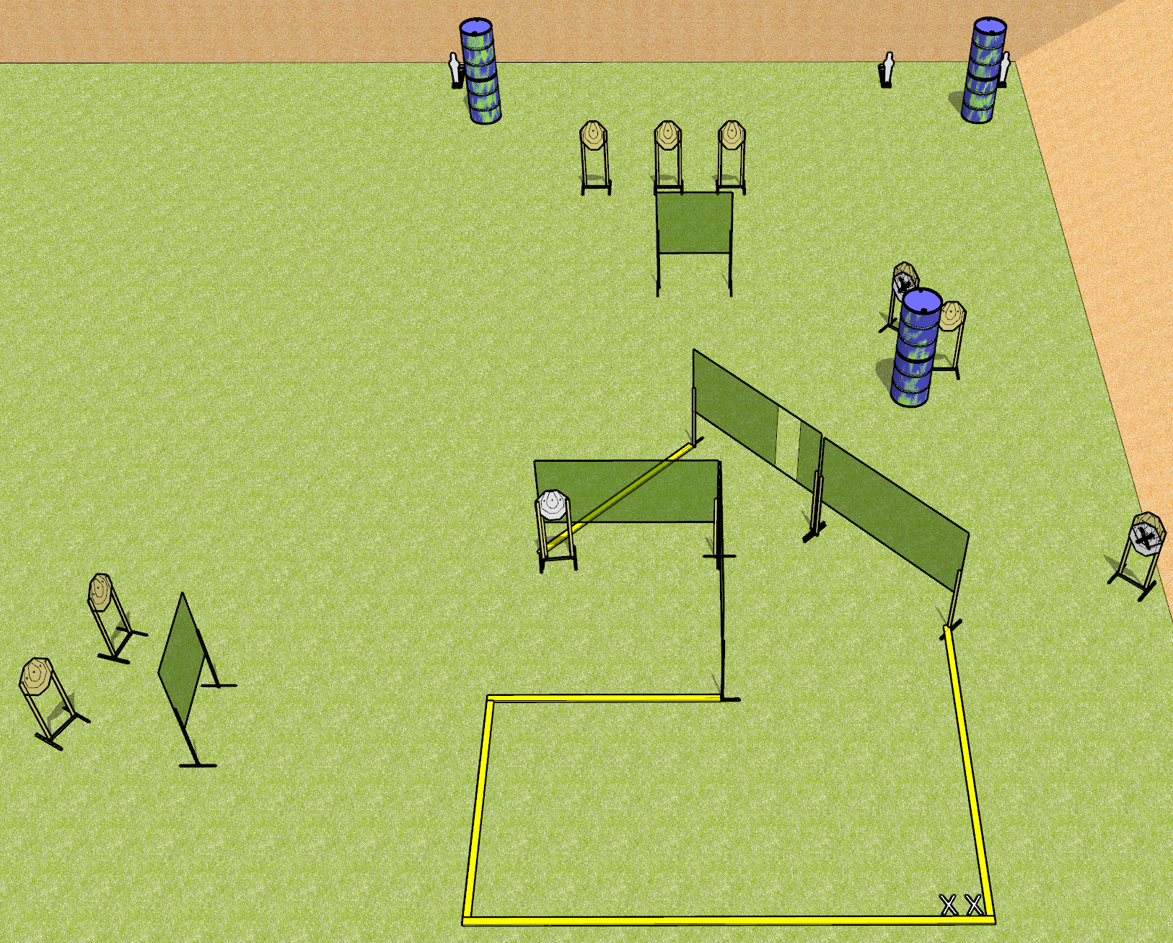
 | Dothan Gun Club – USPSA Match Send It Course Designer : Drew Coleman
Round Count 19 rounds 8 ISPC 3 mini poppers
Equipment List 10 wall feet

Slide 2
Send It
Written Stage Briefing
Send It is a 19 round, 95 point, Comstock course of fire. There are 8 IPSC targets and 3 mini poppers. The best 2 hits on paper will score, and steel must fall to score. The start signal is audible.
Handgun start position is feet on X’s, heels touching rear fault line. Handgun is loaded and holstered.
PCC start position is feet on X’s, heels touching rear fault line, stock on belt. Carbine is loaded with safety on.
On start signal, engage targets as they become available from within the shooting area.

